Slide 1
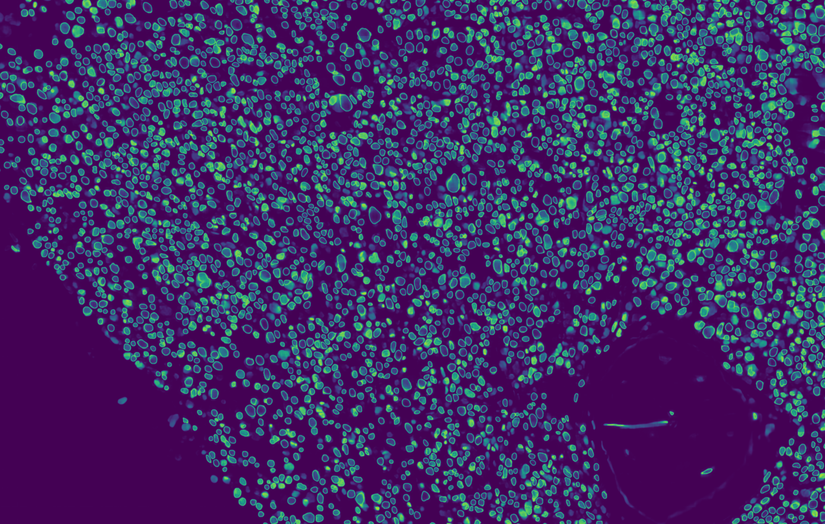
Introduction to Artificial Intelligence: The toolkit for Future-Proof Physicians
Histopathological Image segmentation with Neural Networks

Slide 2
Lecture outline
The problem of image segmentation
Introduction to Neural Networks
Neural Networks for Computer Vision
Histopathological image segmentation

Slide 3
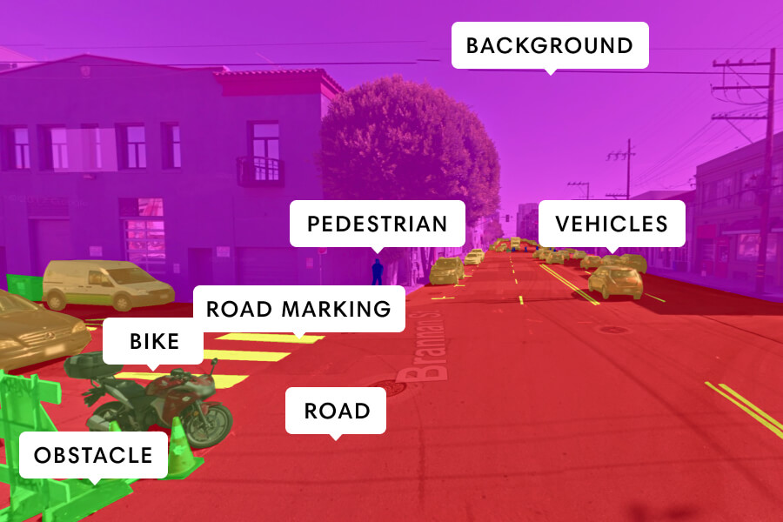
Image segmentation
Image segmentation is the process of dividing a digital image into multiple image regions.
More formally, it is the process of assigning a label to each pixel of the image, so that pixels with the same label belong to the same class of objects.
e. g. Background is class 0, Pedestrian is class 1 and so on.

Slide 4
Principal Applications
Object detection
Face detection and recognition
Autonomous vehicles
Security
Medical Imaging

Slide 5
Classic segmentation techniques
Thresholding
Clustering

Slide 6
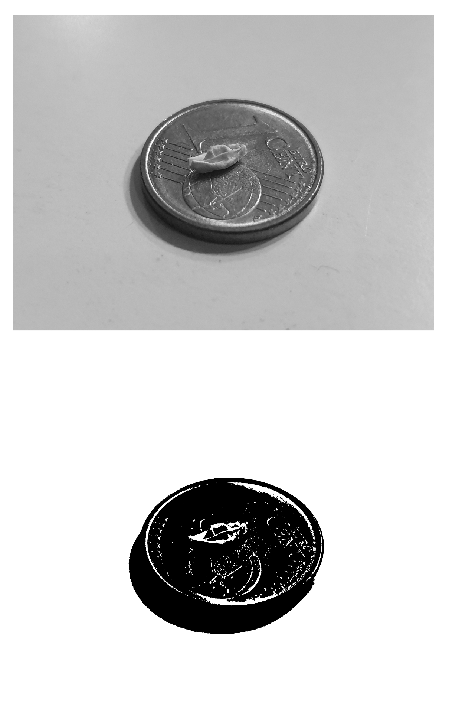
Thresholding
Thresholding is probably the simplest image segmentation method.
In its easiest application, for every pixel in the image, the same threshold value is applied. If the pixel value is smaller than the threshold, it is set to zero, otherwise it is set to the maximum value. This is known as global thresholding.
In this way, thresholding can be used to create binary images, where pixel values are either zero or one.

Slide 7
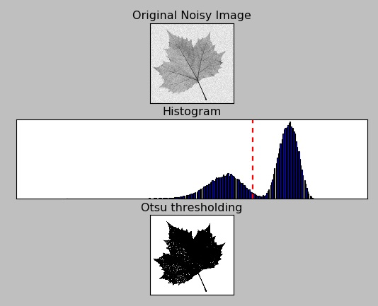
Thresholding
There are also more sophisticated thresholding methods.
Otsu thresholding is a method that automatically finds the optimal threshold value for the image.
Adaptive thresholding applies different threshold values to different regions of the image. This can help in particular when the image lighting is not homogeneous.

Slide 8
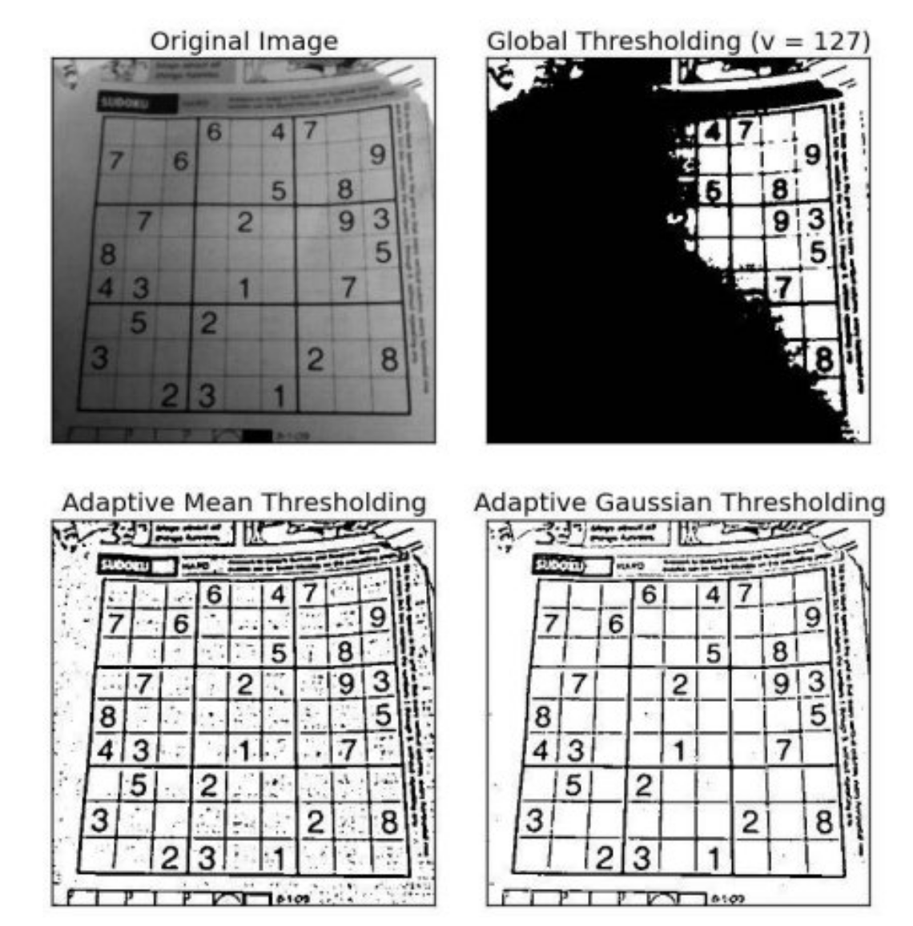
Thresholding
There are also more sophisticated thresholding methods.
Otsu thresholding is a method that automatically finds the optimal threshold value for the image.
Adaptive thresholding applies different threshold values to different regions of the image. This can help in particular when the image lighting is not homogeneous.

Slide 9
Thresholding: when it does not work
High Noise
Low inter-class variance
Inhomogeneous lighting
Complex Images

Slide 10
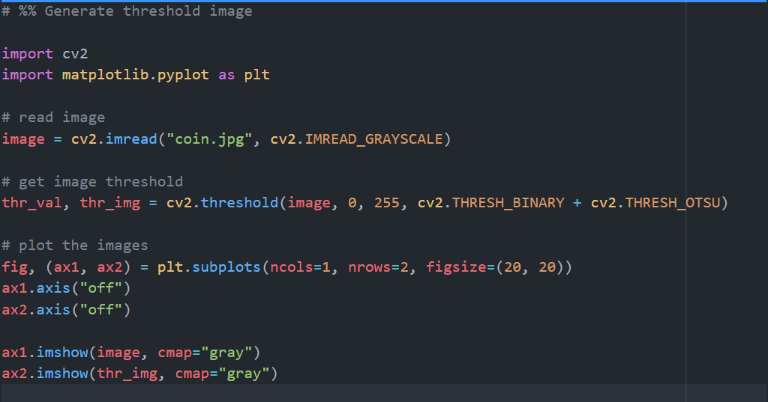
Thresholding in python
Import the libraries
Read the image
Generate threshold image
Plot the two images together

Slide 11
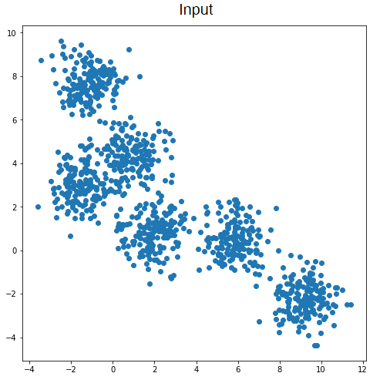
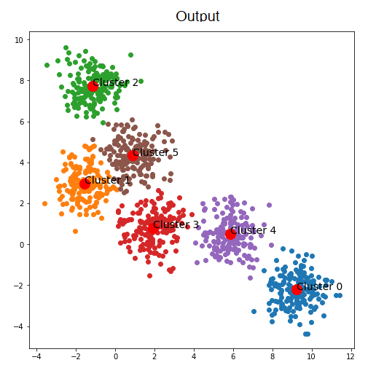
Clustering
Clustering is the process of grouping together similar objects

Slide 12
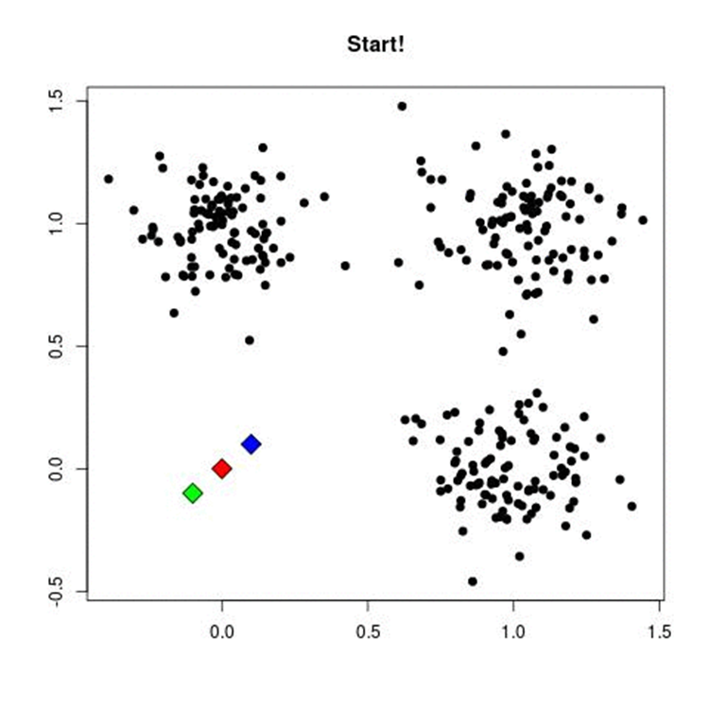
Clustering
In our case, the objects we want to group together are the pixels of the image.
We can compare pixels by their colour and assign pixels with similar colour to the same cluster.
A famous cluster algorithm is the k-means, which works as follows:
Pick K cluster centers randomly
Assign each pixel to the nearest cluster center
Re-compute the cluster centers by averaging all of the pixels in the cluster
Repeat steps 2 and 3 until no pixel changes cluster

Slide 13
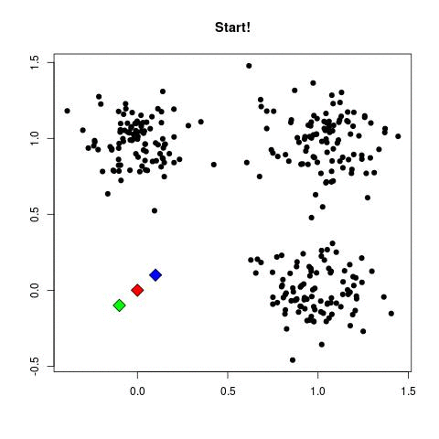
Clustering
In our case, the objects we want to group together are the pixels of the image.
We can compare pixels by their colour and assign pixels with similar colour to the same cluster.
A famous cluster algorithm is the k-means, which works as follows:
Pick K cluster centers randomly
Assign each pixel to the nearest cluster center
Re-compute the cluster centers by averaging all of the pixels in the cluster
Repeat steps 2 and 3 until no pixel changes cluster

Slide 14
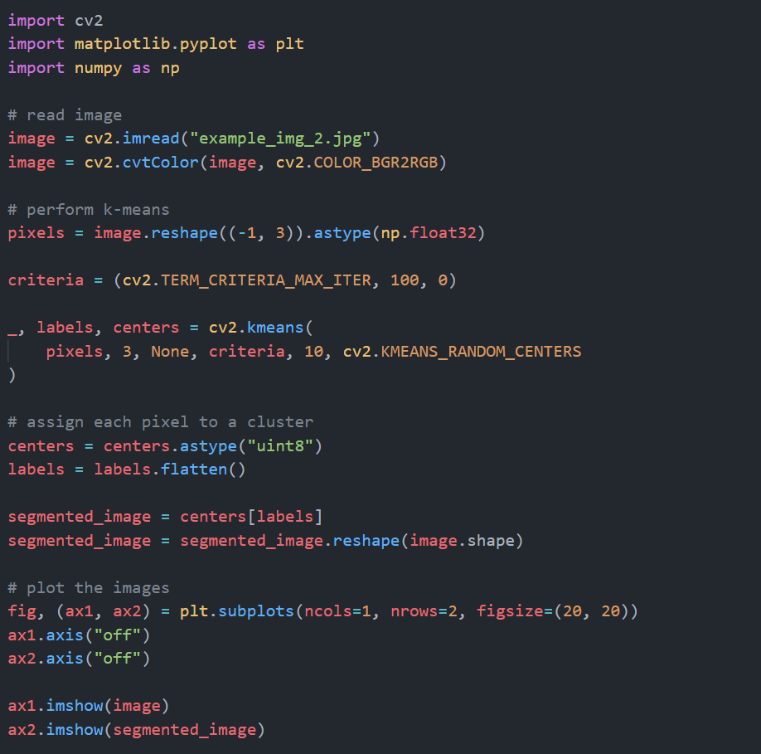
K-means in python
Import the libraries
Read the image
Perform the K-means. Here labels are the clusters associated to each pixel, and centers are the calculated cluster centers
Assign each pixel to its cluster
Plot the images

Slide 15
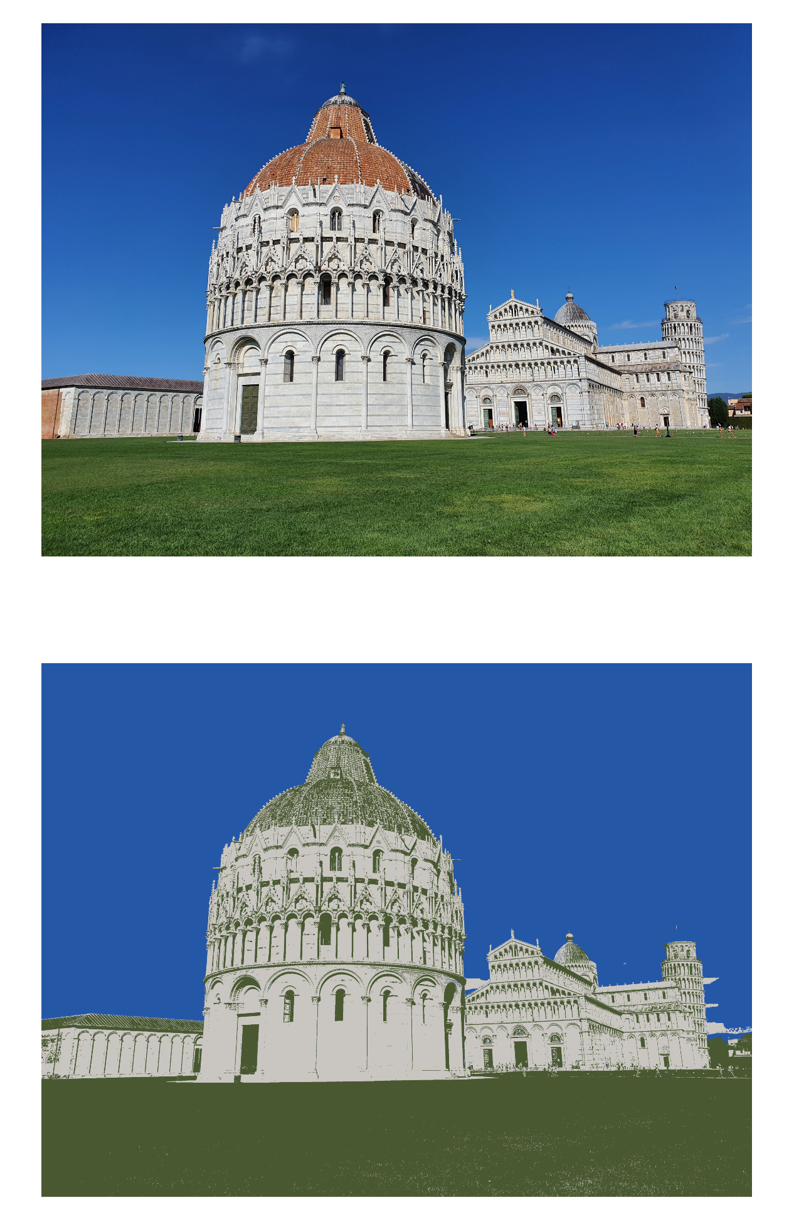
K-means in python

Slide 16
Introduction to Neural Networks: the perceptron
Nowadays, Neural Networks (NN) are among the most discussed topics in science, but, believe it or not, the concept of Neural Network is quite old.
The building block of NN, the perceptron, was invented by Frank Rosenblatt in 1958. It was able to learn whether an input belonged or not to some specific class.
Despite the initial excitement, perceptrons proved to be inadequate in learning complex patterns, and the field of NN was mostly abandoned for many years.

Slide 17
Introduction to Neural Networks: the perceptron
Input
output
x1
w1
x2
w2
1, if f(x) > 0
x3
w3
f(x)
x4
w4
0, if f(x) ≤ 0
w5
x5
f(x) = x1 w1 + x2 w2 + … + x5 w5 + b

Slide 18
Introduction to Neural Networks: the perceptron
The perceptron was intended to be a simplified representation of the human neuron.
It takes a certain number of inputs, assigns a different weight to each input, and sums them together.
In other words, it performs a weighted sum of the inputs.
Then, if this weighted sum is greater than zero, the perceptron is activated (1), otherwise, it is not (0)
x1
w1
w1
x2
w2
w2
x3
w3
f(x)
x4
w4
w5
x5
f(x) = x1 w1 + x2 w2 + … + x5 w5 + b

Slide 19
Introduction to Neural Networks: the multi-layer perceptron
As we said, the perceptron was not sophisticated enough to solve complex problems.
However, it was found that perceptrons with more than one layer, called multi-layer perceptron had a greater processing power and were thus able to learn more complex patterns.
Actually, the universal approximation theorem states that a multi-layer perceptron is able to approximate every possible continuous function!
x1
w1
x2
w2
x3
w3
f(x)
x4
w4
w5
x5
f(x) = x1 w1 + x2 w2 + … + x5 w5 + b

Slide 20
Introduction to Neural Networks: the multi-layer perceptron
Input layer
Hidden layer
Output layer
A multi-layer perceptron (MLP) is made by at least three layers of nodes: an input layer, a hidden layer, and an output layer.
A MLP is thus a specific type of feedforward Neural Network.
Note: usually the term MLP is used to identify any feedforward NN, but, to be specific, the original perceptron used a threshold activation (0 or 1), while current NN neurons use a wide variety of activation functions.

Slide 21
Introduction to Neural Networks: neurons and activations
Except for the input layer, each node of the network is a neuron that uses a non-linear activation function.
One of the most popular activation functions is the Rectified Linear Unit (ReLU)

Slide 22
Introduction to Neural Networks: neurons and activations
ReLU
y
f(x), if f(x) > 0
x1
w1
w2
f(x)
x2
0, if f(x) ≤ 0
w3
x3
w4
x
w5
x4
f(x) = x1 w1 + x2 w2 + … + x5 w5 + b
x5

Slide 23
Introduction to Neural Networks
As we mentioned earlier, a NN as the one showed here is called feedforward NN, because the information flows only in one direction (forward, indeed).
It is also known as fully connected NN, because every neuron of a layer is connected to every neuron of the following layer.
It is the first and the simplest type of Neural Network devised

Slide 24
Introduction to Neural Networks: the learning process
At the beginning of this section we said that the perceptron was able to learn information about the input. A NN, which is a generalization of a perceptron, is also able to learn; but how?

Slide 25
Introduction to Neural Networks: the learning process
In practice, we give an input to the network, for which we expect a certain output. The input flows through the network, and the network makes its prediction (the output).
Input

Slide 26
Introduction to Neural Networks: the learning process
In practice, we give an input to the network, for which we expect a certain output. The input flows through the network, and the network makes its prediction (the output).
Output

Slide 27
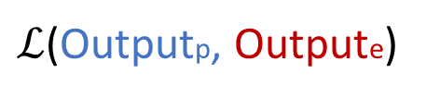
Introduction to Neural Networks: the learning process
We calculate the error of the network, i.e., the difference between the network output (its prediction) and the expected output, and use this information to update the network weights.
$ℒ$(Outputp, Outpute)
Loss Function

Slide 28
Introduction to Neural Networks: the learning process
It follows that if the network makes a big mistake (huge error), the weights are strongly modified. Otherwise, if the error of the network is small, the weights are only slightly changed. The algorithm responsible of the learning process just described is known as backpropagation.
$ℒ$(Outputp, Outpute)
Loss Function

Slide 29
Introduction to Neural Networks: the learning process
Some considerations:
We need to know in advance what is the output associated to a certain input. This is known as supervised learning.
In order to train a Neural Network, i.e., to make it learn, we need a lot of training samples; usually thousands, or tens of thousands. For this reason, it is not easy to apply NNs to medical problems!
The number of weights to update during the learning process can be huge. Networks used for image segmentation usually have millions of weights. This means that we could need a lot of computational power to train a Neural Network.
These last two points are the main reasons why Neural Networks became popular only recently. Nowadays, we have access to a large amount of public data that can be used to train NN, and the computational power of common PCs is enough to train medium/large networks in reasonable amounts of time.

Slide 30
Neural Networks for Computer Vision
Citing Wikipedia, computer vision (CV) is an interdisciplinary scientific field that deals with how computers can gain high-level understanding from digital images or videos.
Among the sub-fields of computer vision, we have object detection, object recognition, image restoration and more.
Neural Networks are currently the state of the art in many of those CV tasks. Actually, NN performance are close to the human counterpart in object detection and classification.
Specific types of Neural Networks are used to analyze image data; they are known as Convolutional Neural Networks.

Slide 31
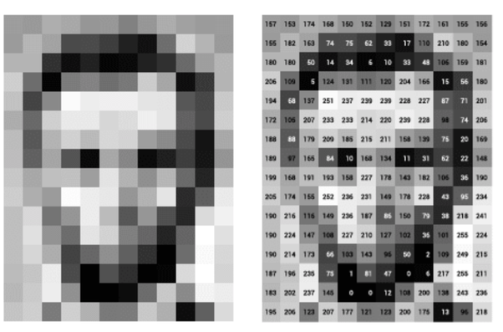
Neural Networks for Computer Vision
The fully connected networks we just introduced are not suited for computer vision tasks, but why?
Actually, it is not an intrinsic problem of those networks. It has to do with the nature of image data.
Mathematically speaking, in fact, images are matrixes of pixels, and each pixel is identified by a single numeric value for grey scale images, or by three numeric values for RGB images.
Now, a full-HD image has 1920x1080 ≈ 2 Million pixels. We said that in a fully connected NN each neuron of a layer is connected to all neurons of the following layer. So, if we want to connect that input image to just one hidden layer with 10 neurons we need 10 x 2 Million = 20 Million weights!
Considering that modern NN usually have tens of hidden layers, it should be clear why fully connected NN can’t be used for image analysis

Slide 32
Convolutional Neural Networks
Convolutional Neural Networks (CNN) are a special kind of NN used primarily for computer vision. They use a mathematical operation known as Convolution in place of the operation carried out by the perceptron we saw earlier.
Despite their elaborate name, the concept behind CNN is quite easy to understand.
A convolutional neuron is a kernel (i.e., a small matrix) of weights. This kernel slides through the input image to produce the output.
This means that the number of weights of a convolutional neuron does not depend on the size of the image but on the size of the kernel!
Convolutional neuron
W1 | W2 | W3
W4 | W5 | W6
W7 | W8 | W9

Slide 33
Convolutional Neural Networks
1 | 0.5 | 1
2 | 1 | 3
0.5 | 2 | 0.5
1 | 0 | 0 | 1 | 0 | 1
1 | 1 | 0 | 1 | 1 | 0
1 | 0 | 0 | 0 | 1 | 0
0 | 1 | 0 | 1 | 1 | 0
0 | 0 | 1 | 1 | 1 | 1
1 | 1 | 0 | 0 | 1 | 1

Slide 34
Convolutional Neural Networks
1 | 0.5 | 1
2 | 1 | 3
0.5 | 2 | 0.5
Input
output
1 | 0 | 0 | 1 | 0 | 1
1 | 1 | 0 | 1 | 1 | 0
1 | 0 | 0 | 0 | 1 | 0
0 | 1 | 0 | 1 | 1 | 0
0 | 0 | 1 | 1 | 1 | 1
1 | 1 | 0 | 0 | 1 | 1
4.5
1 + 0 + 0 + 2 + 1 + 0 + 0.5 + 0 + 0 = 4.5

Slide 35
Convolutional Neural Networks
1 | 0.5 | 1
2 | 1 | 3
0.5 | 2 | 0.5
Input
output
1 | 0 | 0 | 1 | 0 | 1
1 | 1 | 0 | 1 | 1 | 0
1 | 0 | 0 | 0 | 1 | 0
0 | 1 | 0 | 1 | 1 | 0
0 | 0 | 1 | 1 | 1 | 1
1 | 1 | 0 | 0 | 1 | 1
4.5 | 6
0 + 0 + 1 + 2 + 0 + 3 + 0 + 0 + 0 = 6

Slide 36
Convolutional Neural Networks
1 | 0.5 | 1
2 | 1 | 3
0.5 | 2 | 0.5
Input
output
1 | 0 | 0 | 1 | 0 | 1
1 | 1 | 0 | 1 | 1 | 0
1 | 0 | 0 | 0 | 1 | 0
0 | 1 | 0 | 1 | 1 | 0
0 | 0 | 1 | 1 | 1 | 1
1 | 1 | 0 | 0 | 1 | 1
4.5 | 6 | 4.5
0 + 0.5 + 0 + 0 + 1 + 3 + 0 + 0 + 0.5 = 4.5

Slide 37
Convolutional Neural Networks
1 | 0.5 | 1
2 | 1 | 3
0.5 | 2 | 0.5
Input
output
1 | 0 | 0 | 1 | 0 | 1
1 | 1 | 0 | 1 | 1 | 0
1 | 0 | 0 | 0 | 1 | 0
0 | 1 | 0 | 1 | 1 | 0
0 | 0 | 1 | 1 | 1 | 1
1 | 1 | 0 | 0 | 1 | 1
4.5 | 6 | 4.5 | 7
1 + 0 + 1 + 2 + 1 + 0 + 0 + 2 + 0 = 7

Slide 38
Convolutional Neural Networks
1 | 0.5 | 1
2 | 1 | 3
0.5 | 2 | 0.5
Input
output
1 | 0 | 0 | 1 | 0 | 1
1 | 1 | 0 | 1 | 1 | 0
1 | 0 | 0 | 0 | 1 | 0
0 | 1 | 0 | 1 | 1 | 0
0 | 0 | 1 | 1 | 1 | 1
1 | 1 | 0 | 0 | 1 | 1
4.5 | 6 | 4.5 | 7
5.5
1 + 0.5 + 0 + 2 + 0 + 0 + 0 + 2 + 0 = 5.5
And so on…

Slide 39
Convolutional Neural Networks
Convolutional Neural Networks were also inspired by the structure of the brain. In the visual cortex, indeed, individual cortical neurons respond to stimuli only in a restricted region of the visual field, known as the receptive field.
In the same way, each convolutional neuron processes data only for its receptive field. The receptive field of a convolutional neuron is the size of its kernel. A bigger kernel means a larger receptive field for that neuron, but it also means more weights to train. In a fully connected network, the receptive field of a neuron is the entire previous layer.
The output produced by the convolution of the kernel on the input image is called feature map.
CNNs, similarly to fully connected NN, are made up by an input layer, some hidden convolutional layers, and an output layer. Convolutional layers and fully connected layers can also be used together in the same network, depending on the specific needs.

Slide 40
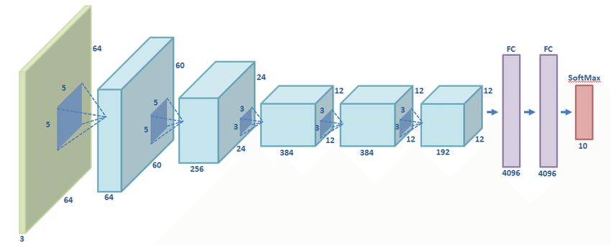
Convolutional Neural Networks
The output produced by the convolution of the kernel on the input image is called feature map.
CNNs, similarly to fully connected NN, are made up by an input layer, some hidden convolutional layers, and an output layer. Convolutional layers and fully connected layers can also be used together in the same network, depending on the specific needs.
Input Image
Convolutional layer
Fully connected layer
Final activation

Slide 41
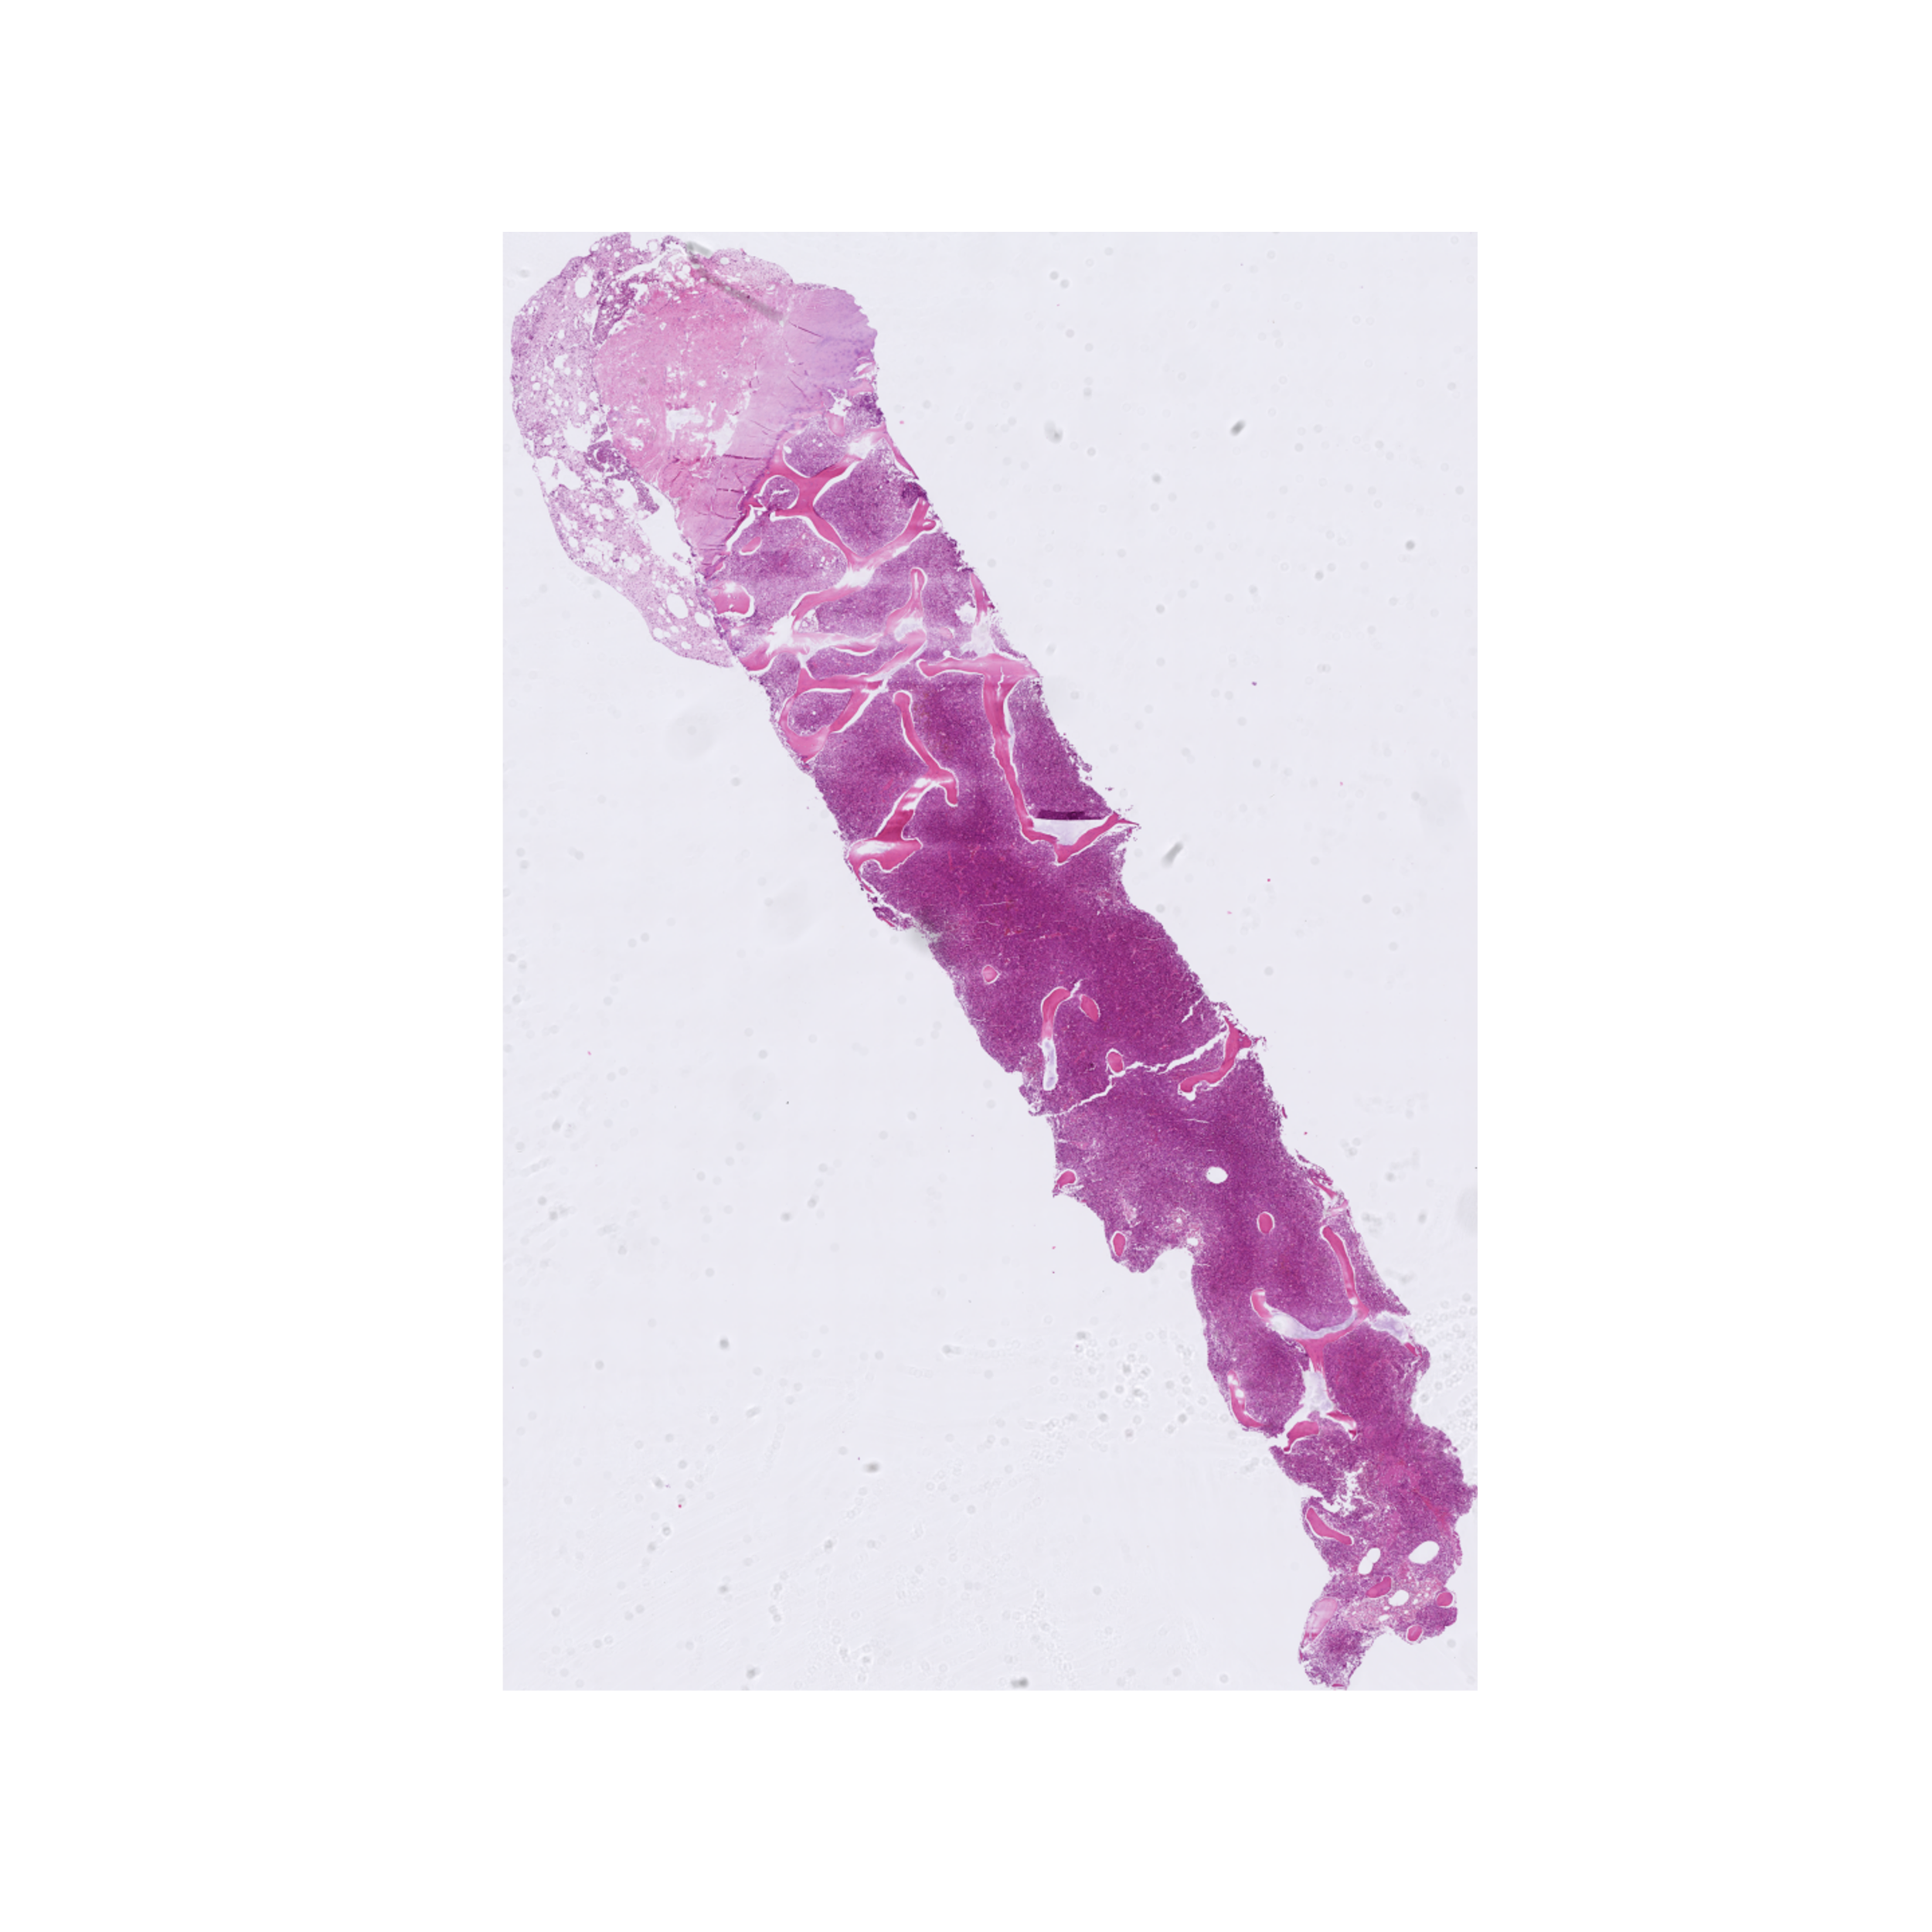
Histopathological image segmentation
Histopathology is the diagnosis and study of diseases of the tissues and involves examining tissues and/or cells using a microscope.
The examination of these tissues is carried out by Histopathologists which are then responsible of making diagnoses about patient’s condition.
Artificial intelligence (AI) can have an important role in the analyses of histopathology slides.
AI algorithms can extract valuable information from these images, helping physicians in the diagnosis process.
Moreover, computers can conduct the analyses very quickly, so they have the potential of reducing diagnosis timing.
The amount of information encoded in an image like the one on the right is enormous. To have an idea, let’s take a closer look.

Slide 42
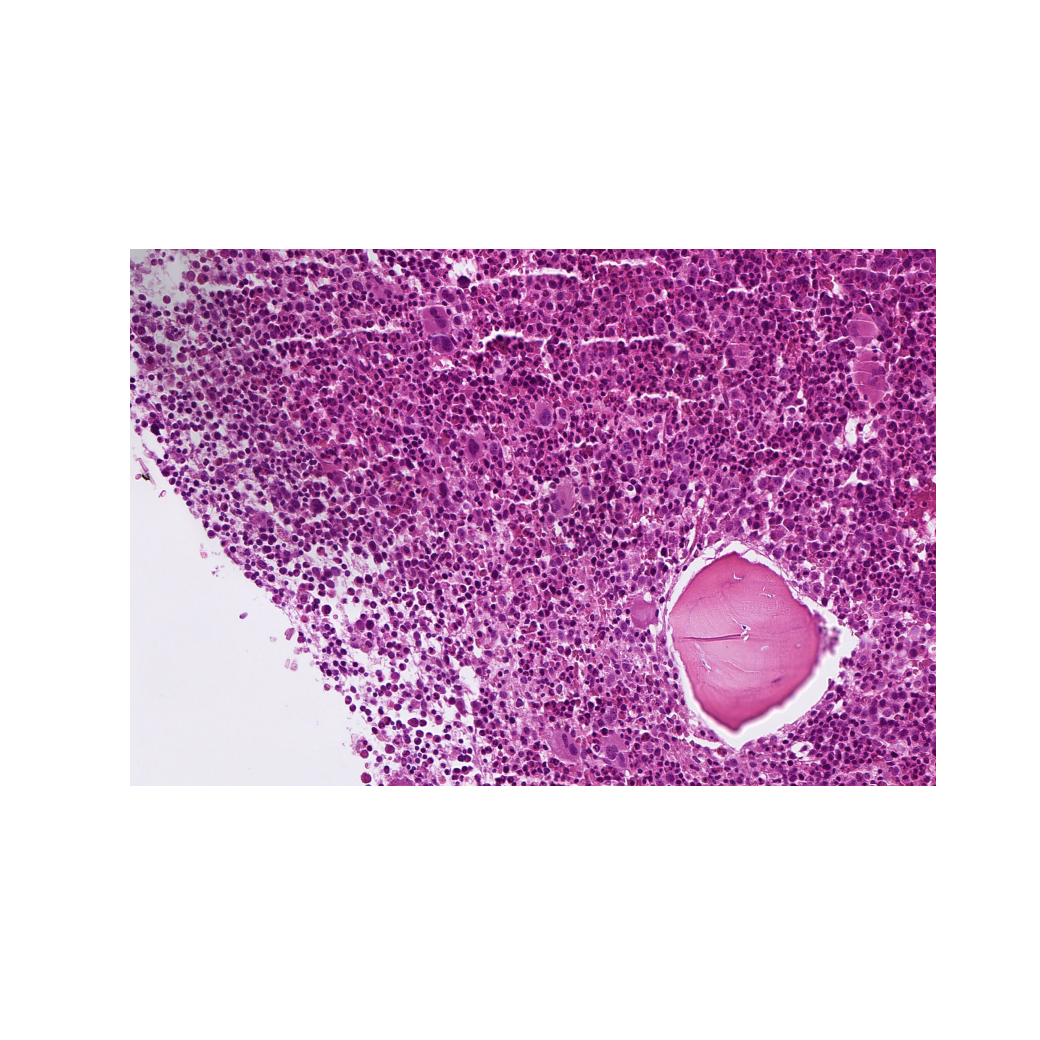
The amount of information encoded in an image like the one on the right is enormous. To have an idea, let’s take a closer look.

Slide 43
From each nucleus we see in the image on the left we can extract important information, such as the area, the perimeter, the radius, the colour and so on.
These features can be used to classify different nuclei and the extracted information can be used to build powerful models that can help histopathologists in their work.
In order to get this information we first have to teach a Neural Network how to recognize the nuclei in the image.
Let’s see how do we do that in practice.

Slide 44
Histopathological image segmentation: staining
The colour of these images depends on the specific staining that is used. Staining is a technique used to enhance contrast in samples.
The stain used in the image on the right is called haematoxylin-eosin stain, often abbreviated as H&E stain. It is the most used stain in medical diagnosis. The hematoxylin stains cell nuclei a purplish blue, and eosin stains the extracellular matrix and cytoplasm pink.

Slide 45
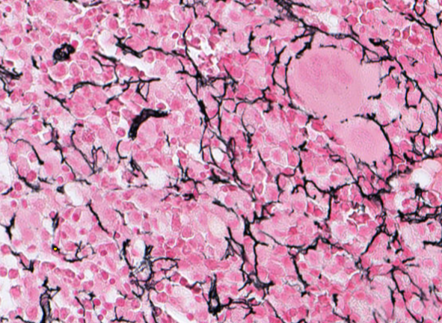
Histopathological image segmentation: staining
H&E
The colour of these images depends on the specific staining that is used. Staining is a technique used to enhance contrast in samples.
The stain used in the image on the right is called haematoxylin-eosin stain, often abbreviated as H&E stain. It is the most used stain in medical diagnosis. The hematoxylin stains cell nuclei a purplish blue, and eosin stains the extracellular matrix and cytoplasm pink.
Gomori
Many other stains exist. Here is an example of Gomori stain.
Neural Networks trained on one specific stain will probably fail in predicting images with different stains.
This is an important thing to keep in mind about Neural Networks: they are extremely task-specific.

Slide 46
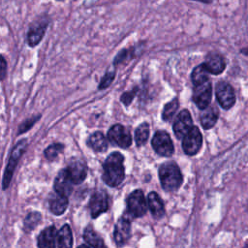
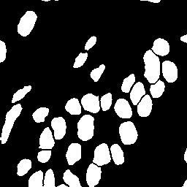
Histopathological image segmentation
Image
As we mentioned earlier, to teach something to a Neural Network we need a lot of examples. In this case, we need many histopathological images and their associated annotations, i.e., the manual segmentations of the nuclei.
To give an idea about how many images we typically need, the dataset from which I got the images on the right contains roughly 7500 images with the associated annotations.
Annotation
In practice, for the learning process, we give the images to the network as input, and ask it to predict the annotations. It has to predict 0 if the pixel is a background pixel, and 1 if it is a nucleus pixel.

Slide 47
Histopathological image segmentation
Once the network is trained we can use it to make predictions on new images. Let’s see the prediction of the network for the image we saw earlier:

Slide 48
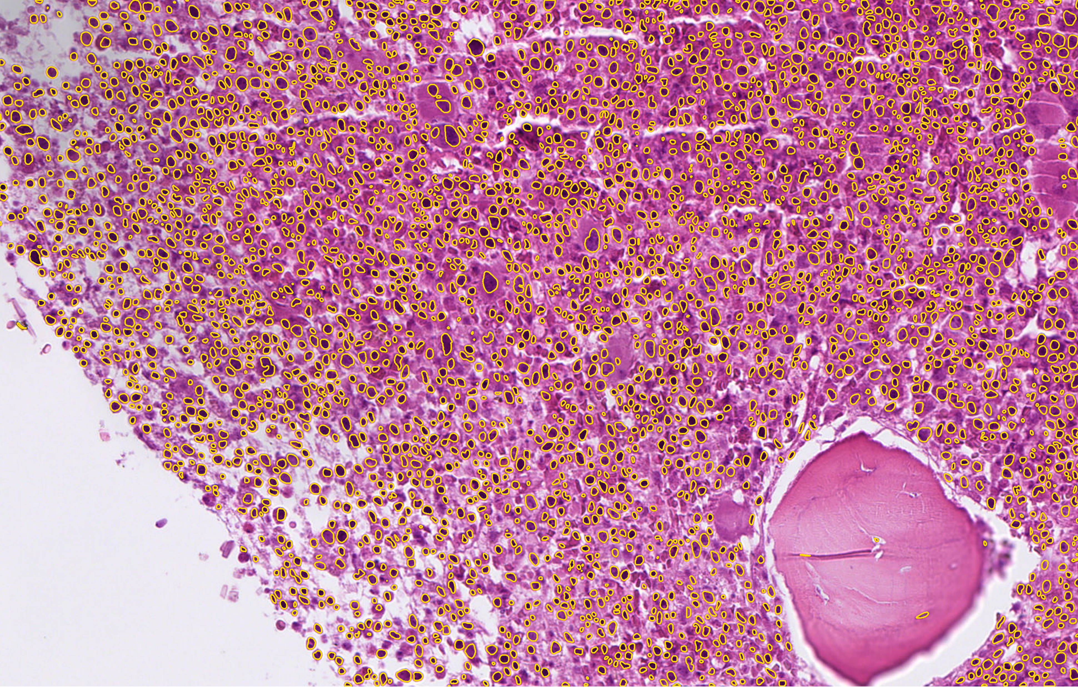
Once the network is trained we can use it to make predictions on new images. Let’s see the prediction of the network for the image we saw earlier:

Slide 49
Histopathological image segmentation
The network did an impressive job!
The other impressive thing is that the segmentation of all those nuclei takes roughly 6/7 seconds on a standard PC.
In conclusion, AI can be a powerful instrument to improve medical sciences, and to make it work best, the collaboration between medical experts and computer scientists is fundamental.
In this way, it will be possible to build the medicine of the future.

Slide 50
Thank You for the attention!

